Slide 1
Skill mismatches
How to get prepared for the today’s labour market?
Mr. Borbély-Pecze, Tibor Bors, PhD. habil.
Associate Processor at JWTC/
Hungarian Pedagogical Society
Baku, 21st of December 2022

Slide 2
Definition: Skills mismatch
discrepancy between the skills that are sought by employers and the skills that are possessed by individuals.
mismatch between skills and jobs
education and training are not providing the skills demanded in the labour market OR
economy does not create jobs that correspond to the skills of individuals. (ILO, 2020)

Slide 3
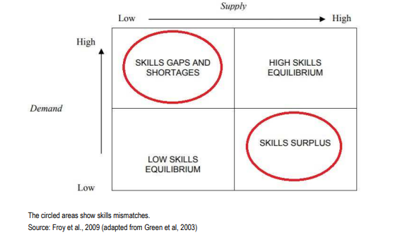
Low- and high-skilled equilibrium and skills mismatch

Slide 4
Effects at different levels: individuals/ governments/ companies
At the individual level there are serious wage penalties especially for over qualification that eventually affect both job and life satisfaction.
For companies skills mismatch has negative consequences for productivity and competitiveness, which affects their ability to implement new products, services or technologies
For countries and regions skills mismatch can increase unemployment, and affect competitiveness and attractiveness to investors, meaning lost opportunities on the pathway to productive transformation and job creation. (ILO, 2020)

Slide 5
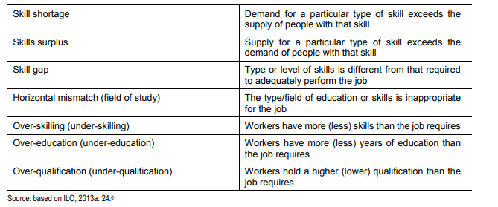
Different types of skills mismatch

Slide 6
Solutions and approaches
In less formal economies
Informal apprenticeships
are the primary source of technical and vocational skills development in Sub-Saharan Africa, South Asia and even Latin America, and is emerging in importance in countries in Central Asia.
This sort of training is very relevant to enterprises that take on a learner and usually more accessible than formal technical and vocational training programmes, but it does suffer from quality concerns
On-the-job learning by doing
refers to unstructured experiential learning where there is no planned intent to be trained by a more experienced person (as in an apprenticeship), but where technical, vocational, or transferable skills are acquired in the process of an individual carrying out day to day work
Non-formal skills training
aimed at youth and/or adults is often short duration (typically 1-6 months), and may be skills training
Non-traditional means of acquiring skills
People acquire skills throughout their lives via non-traditional means, including for example from TV, the internet, radio, smart phones, reading, computer gaming, playing sports, participation in community clubs, associations and societies. (ILO, 2017).
In formal economy
Short-term training by the state-firms-individuals & ILA (individual learning account) give people of working age a budget to spend on training to improve their skills and employability. (EC, 2022)
validation of non-formal and informal learning
A skills validation process allows individuals to identify, document, assess and certify their skills. (EC,2022)
Job evaluation method: The job evaluation method is based on the assessments of professional job analysts who are tasked with measuring the educational requirements of occupations for the purpose of constructing occupational dictionaries (such as DOT or O*NET in the United States or SOC in the UK, ESCO in the EU.

Slide 7
What can be done in Azerbaijan?
Companies level: it negatively effect productivity and competiveness
What to do?
offer short type mentoring programmes
validate the non-formal and informal skills of your employees
apply job evaluation and reorganisation
At the individual level it effects wages, job satisfaction, job mobility
What to do?
Use career guidance and validation services
Develop your skill portfolio and keep it updated
use your savings for learning as well via ILA
Relay on your community for informal apprenticeship and informal/ non-formal online learning
At the state/ city level: lower tax income, less competitive economy
What to do?
Develop competency-based matching like ESCO
Finance ILA
Set up career counselling and validation services

Slide 8
References
European Economic and Social Committee (2018). Skills Mismatches An Impediment to the Competitiveness of EU Businesses https://epale.ec.europa.eu/sites/default/files/skills_mismatches.pdf
ILO (2020). What is skills mismatch and why should we care? Geneva
https://www.ilo.org/skills/Whatsnew/WCMS_740388/lang--en/index.htm
ILO (2017). / ROBERT PALMER: JOBS AND SKILLS MISMATCH IN THE INFORMAL ECONOMY https://www.ilo.org/wcmsp5/groups/public/---ed_emp/---ifp_skills/documents/publication/wcms_629018.pdf
ILO (2017). How Useful is the Concept of Skills Mismatch? Seamus McGuinness, Konstantinos Pouliakas, Paul Redmond https://www.ilo.org/wcmsp5/groups/public/---ed_emp/---ifp_skills/documents/publication/wcms_552798.pdf
CEDEFOP (2012) Skill mismatch: The role of the enterprise. Luxembourg https://www.cedefop.europa.eu/files/5521_en.pdf

Slide 9
A few fresh own references
Borbély-Pecze (2022). Обзор международных практик и инновационных подходов к предоставлению услуг по профориентации и карьерному консультированию: Overview of international best practices and innovative approaches to career guidance services (pp.12) ILO Moscow Office (draft)
Borbély-Pecze Tibor Bors, Florian Kadletz, European Training Foundation (ETF) (2022). A REVIEW OF NATIONAL CAREER DEVELOPMENT SUPPORT SYSTEMS: Armenia, Azerbaijan, Georgia and Ukraine
Borbély-Pecze T. B., Hloušková L., Šprlák T. (2021). Career/lifelong guidance systems and services: continuous transformations in a transition region: The case of three Central and Eastern European Countries INTERNATIONAL JOURNAL FOR EDUCATIONAL AND VOCATIONAL GUIDANCE 21 : 2 pp. 1-25. , 25 p.
Borbély-Pecze Tibor Bors (2021). Labour market management skills among career practitioners: tackling increasing complexity In: Harrison, Cynthia; Villalba, Ernesto; Kettunen, Jaana; Vuorinen, Raimo (eds. ) Digital transitions in lifelong guidance: rethinking careers practitioner professionalism: a CareersNet expert collection. Luxembourg, Luxemburg : ETF (Cedefop) pp. 103-119. , 17 p.

